Slide 1
Use of Games in Education
Jacob Heidenreich
Loras College
ISQGD-SS16
Oct. 10 2026

Slide 2
Learning is Work
Math learning needs time, energy, and effort
  No royal road (Euclid to Ptolemy I)
Video game player example
  Energy to do something vs. energy to make yourself do something
Promise of Playful Learning: effortful intention, effortless making yourself do it.
Civ III vs. the dissertation

Slide 3
Outline
Use of Games I
  Game designed to teach
Use of Games II
  Use math to analyze games
Use of Games III
  Gamifying a class explicitly
Use of Games IV
  Gamifying a class implicitly

Slide 4
Use of Games I
Designing games to teach math
  Freedom withing structure
Great Function Race- skills
  Great Function Race Slips
Function Battleship-fluency
  Function Battleship functions
  Function Battleship grid

Slide 5
Use of Games II
Learning how to use math in analyzing games
  Catan 2-12’s
  Pandemic- identify variables, collect data, look for relations

Slide 6
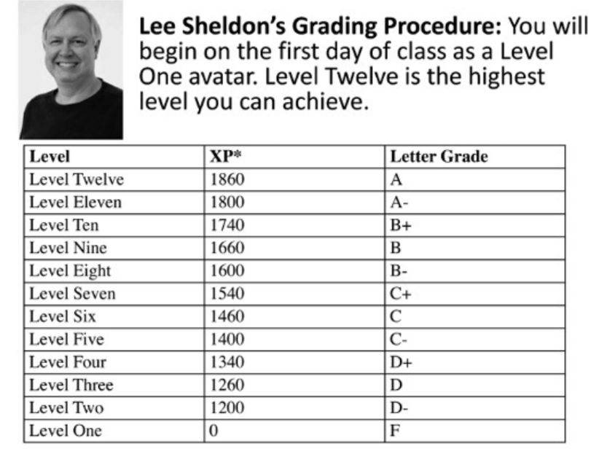
Use of Games III
Gamify the class Explicitly
  Lee Sheldon, “The Multiplayer Classroom”
  John Eby’s Lord of the Rings Class

Slide 7
Use of Games IV
Gamify the classroom implicity
  Tetris online hw
  Give them an opportunity to experience agency
  The magic circle and experimenting with a topic in a low-stakes environment
    Productive struggle

Slide 8
Conclusion
Magic Circle
  Hutzinga’s “Homo Ludens”
Magic Circle in education and safe to explore and learn math
Final recommendation: Bernie DeKoven’s “The Well-Played Game”

Slide 9
Some Resources
Link to an annotated bibliography:
  Annotated Bibliography
  Highlight: Teaching Mathematics Through Games
Print-and-play math games I’ve designed:
  Math Games
My contact information:
  Contact info

